Slide 1
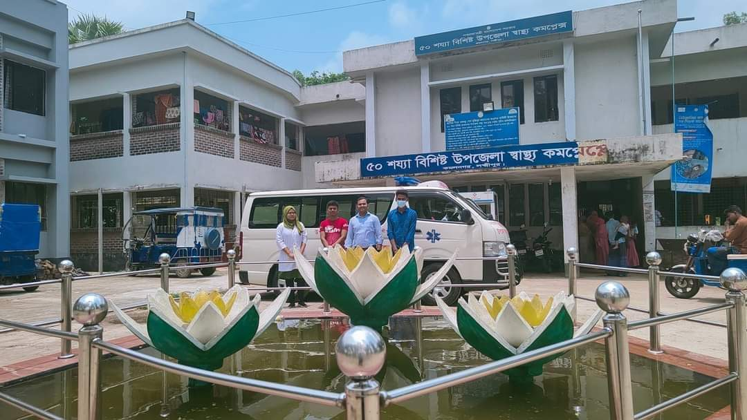
50 BEDED UPAZILA HEALTH COMPLEX
Kamalnagar, Lakshmipur.

Slide 2
A Sub-district level Hospital with a Vision …
Maximum utilization of Govt.
resources with
honesty and sincerity
Integrated approach of
Administration, Community
Leaders & Health
Management
Providing Effective and
prompt services
through improved
management system

Slide 3
Health Profile of Kamalnagar UHC - 2022
1. Total population : 2,63,545
2. Total Fertile Couples : 34576
3. Total Pregnant : 1518
4. Total Delivery : 1737
5. Total Live birth : 1724
6. Total death :
7. Total Maternal death : 02
Human Resource
a. Doctor : 19 ( 11 + 8)
b. Nurse : 15
c. HA : 25
d. SBA : 2HA +4 FWA + 1CHCP
e. CHCP : 21
f. Volunteer, Security guard & cleaner: 14
9. Health Institutions
a. Health Complex : 01
b. H & FWC : 4 (Sub-2 FWC– 2 )
c. Community clinic : 22
d. Non- Govt. Clinic : 02

Slide 4
Contd.
10. Mother taken ANC 1st visit :
11. Mother taken ANC 4th visit :
12. Hospital Delivery Rate :
13. No. of Hospital bed : 50
14. Bed Occupancy Rate :108%
15. Contraceptive Prevalence Rate (CPR):
16. Total Fertility Rate (TFR) :
17. Maternal Mortality Ratio :
18. Neonatal Mortality Rate :
19. Infant Mortality Rate :
20. Under-5 Mortality Rate :

Slide 5
Background History of Kamalnagar UHC
Kamalnagar UHC started as 31 bedded Hospital in 1981
The Health complex upgraded to 50 bedded in.
From 2012 UH&FPO started 3 special activates
3 Special activities:
ANC-Corner
Basic EOC service
IMCI Corner for under 5 children

Slide 6
Contd.
NCD Corner started from 1st January-2021
KMC and SAM corner started from January 2021.
Essential packages for ANC patient started from August 2021.
Women and child friendly Hospital declared in 2021.
Safe Blood Transfusion unit established in 2022.
SSK program starts in July 2022.

Slide 7

Kamalnagar UHC
Bed Occupancy Rate from 2017 to 2022

Slide 8
Emergency & Out Door, Indoor Service 2017 to July-2022
Kamalnagar UHC

Slide 9
Kamalnagar UHC
EOC Activities : 2017 to 2022 (Hospital Delivery )

Slide 10
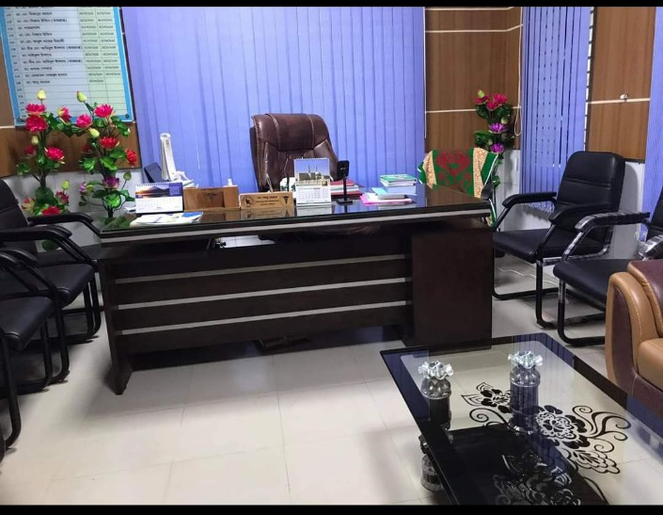
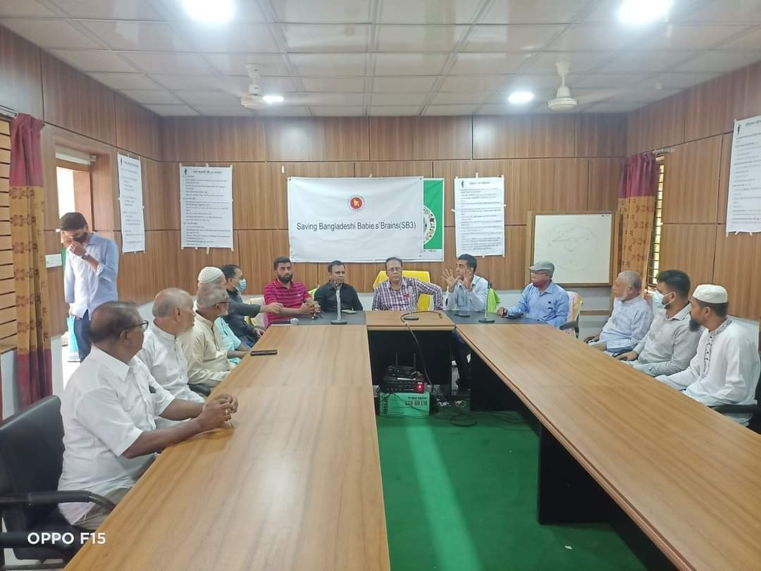
Well-decorated UH&FPO Room and Conference Room
UH&FPO Room
Conference Room

Slide 11
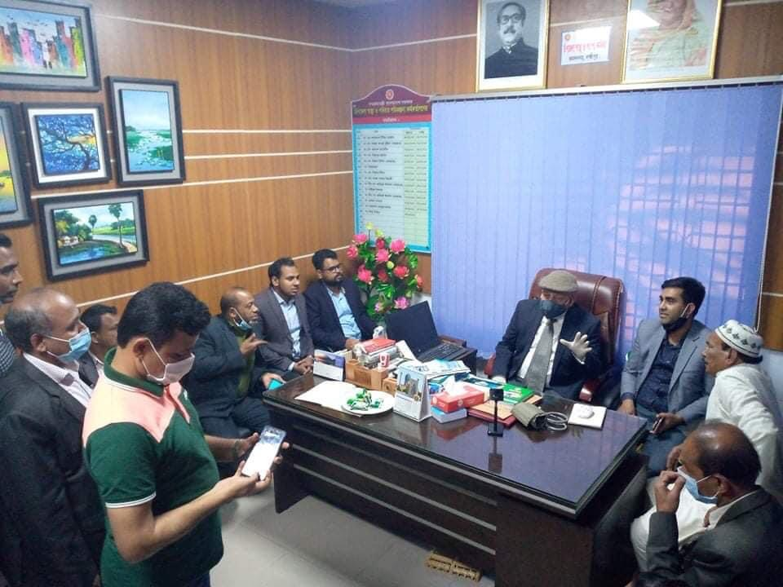
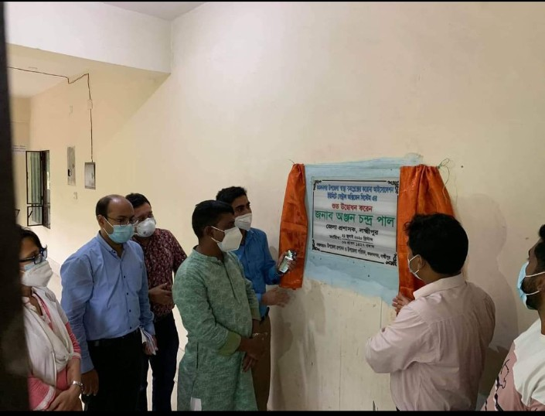
Visit of Local MP and Establishment of Central Oxygen Supply System
Visit of Major (Rtd.) Abdul Mannan MP on 11 Feb 2021
Establishment of Central Oxygen System, July 2020

Slide 12
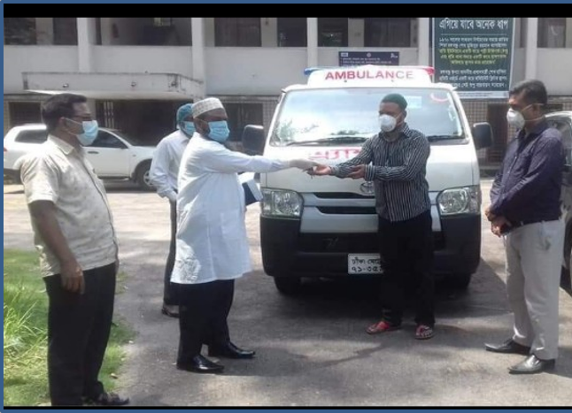
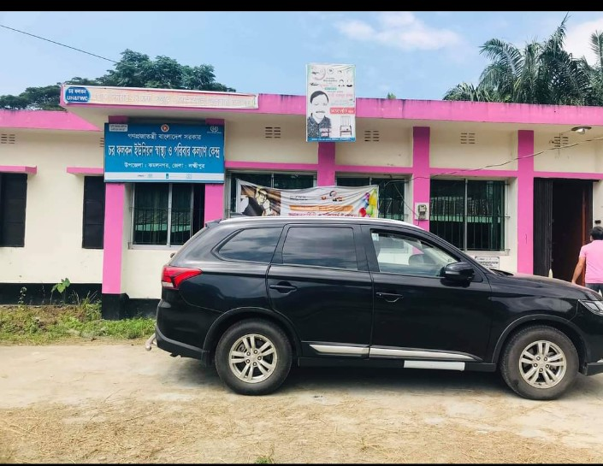
Receiving of Ambulance and Jeep from
Civil Surgeon, Lakshmipur
Ambulance receiving from Civil Surgeon on August 2020
Jeep for UH&FPO

Slide 13
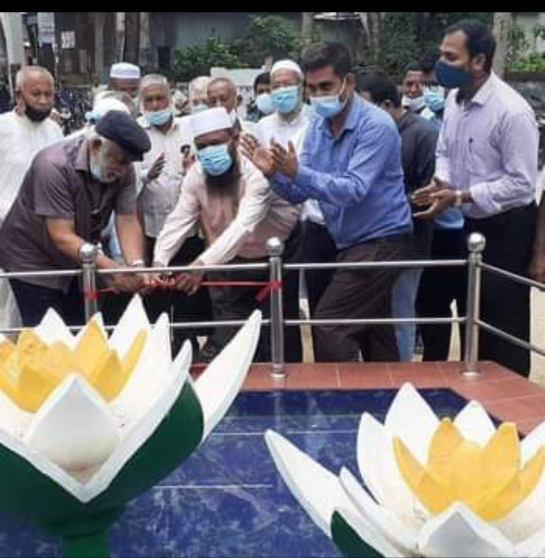
Inauguration of Muktijudda Shapla Chattor by Civil Surgeon, Lakshmipur and Muktijudda commander, Sep-2021

Slide 14
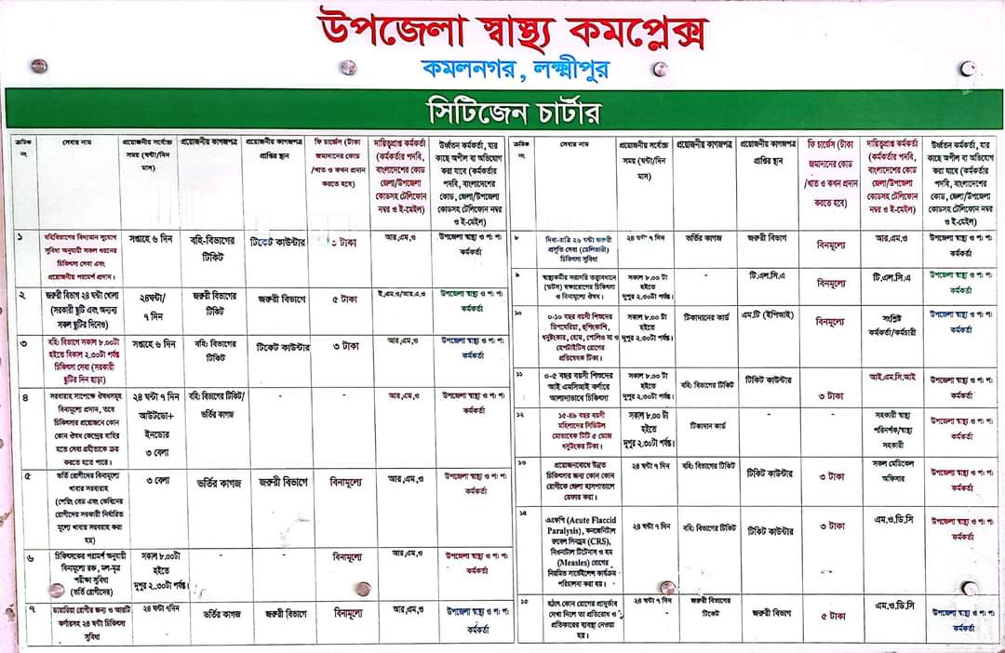
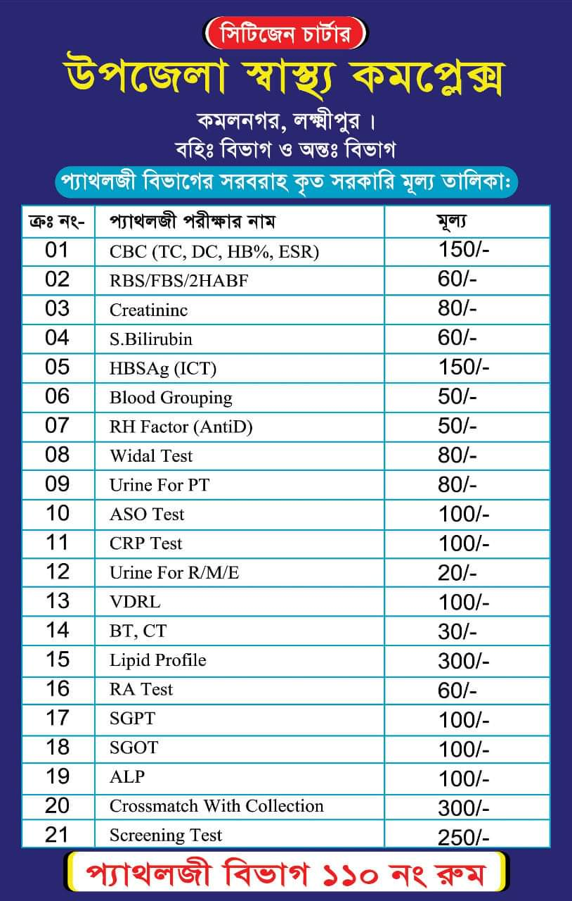
Citizen charter, Pathological Investigation Chart
Citizen Charter of the UHC
Pathological Investigation Fee Chart

Slide 15
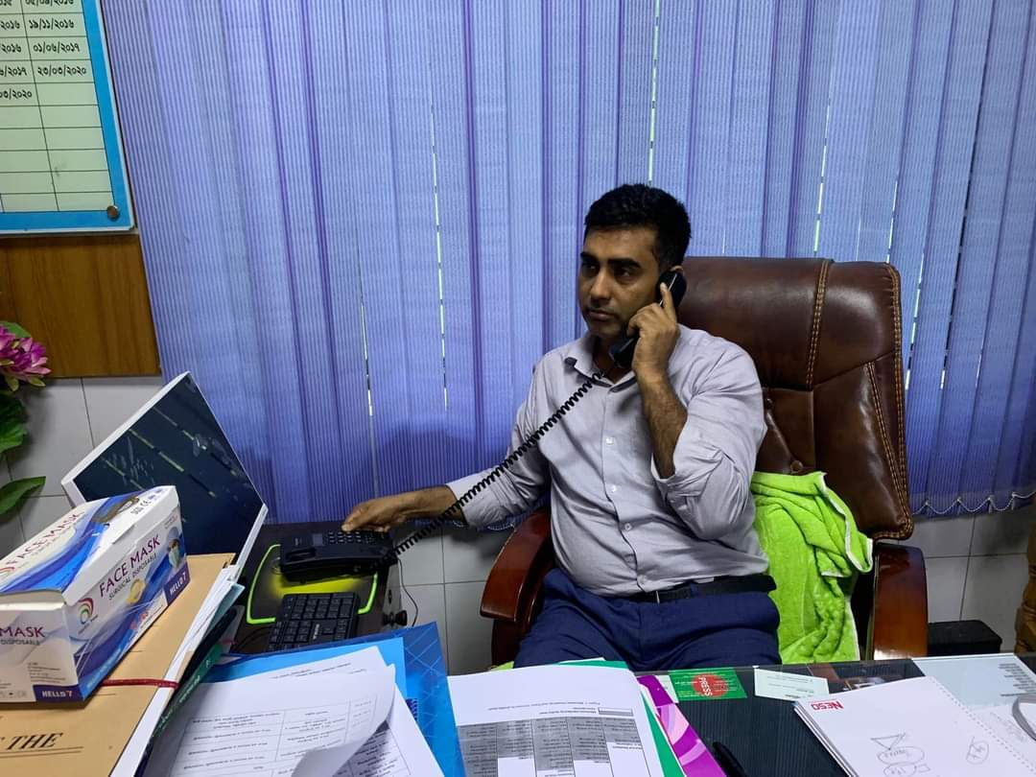
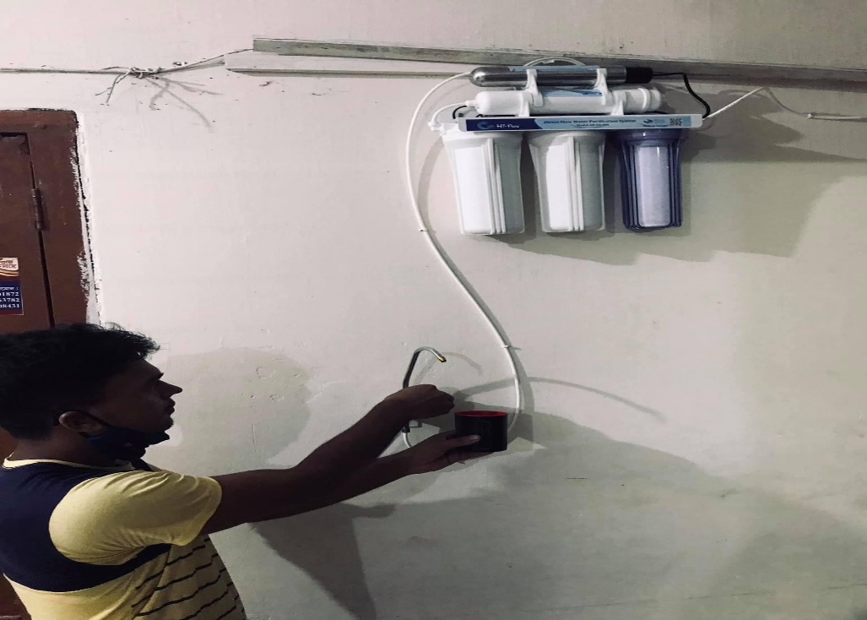
Intercom and Safe Drinking Water Facility in Kamalnagar UHC
Intercom
Safe Drinking Water Supply

Slide 16
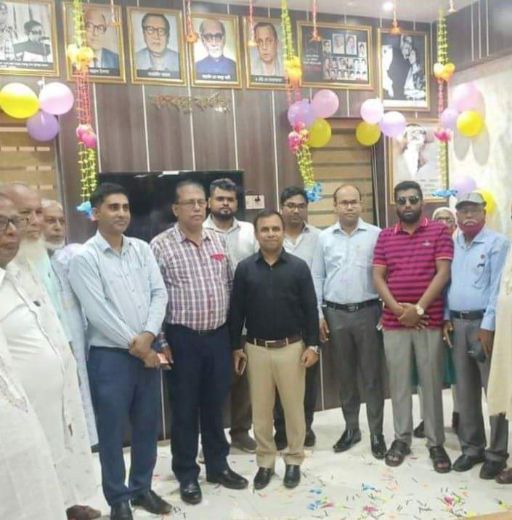
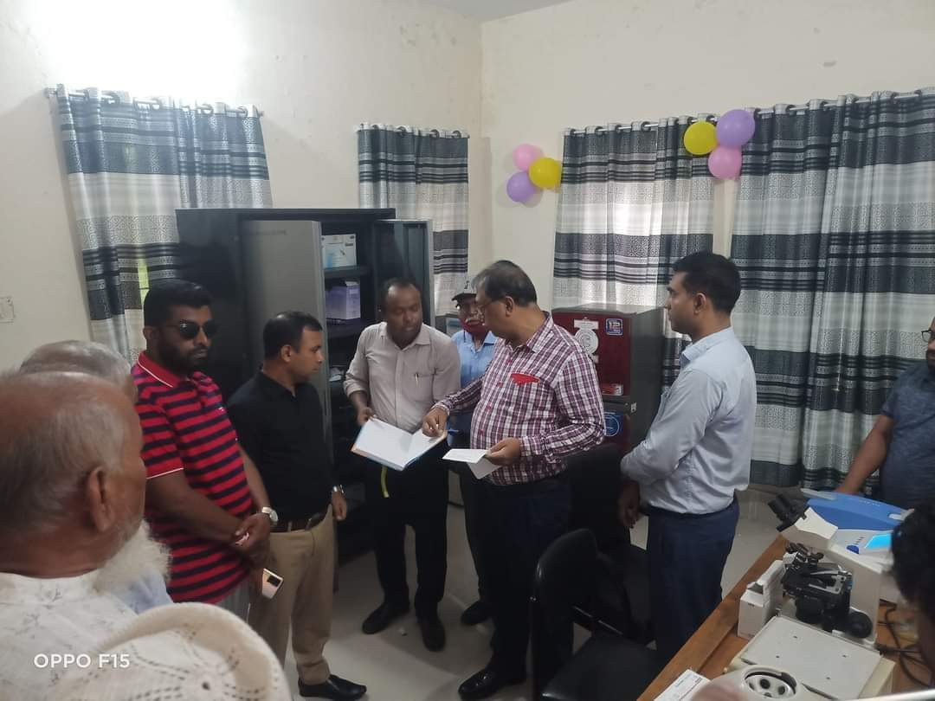
Inauguration of Pathology department, NCD Corner and Bangabandhu Corner, July-2022
NCD and Bangabandhu Corner
Pathology Department

Slide 17
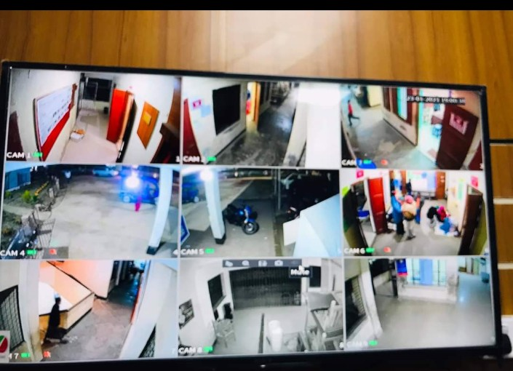
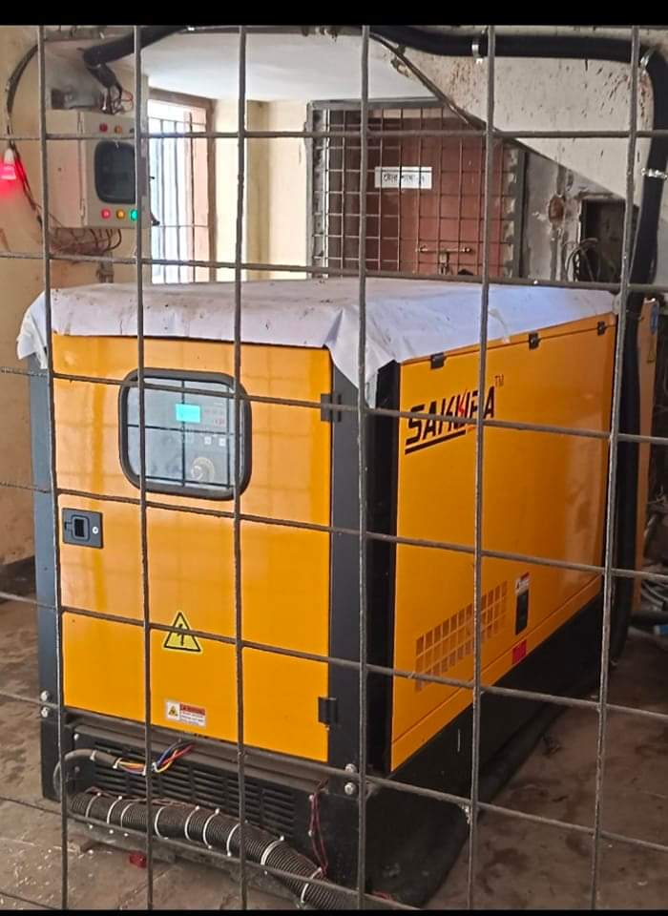
CCTV camera and Generator in Kamalnagar UHC
Functioning CCTV Camera
Functioning Generator

Slide 18
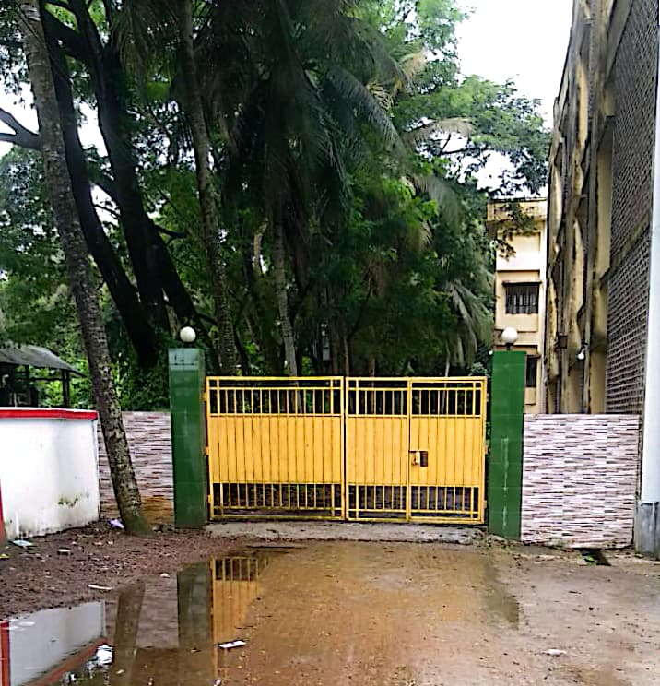
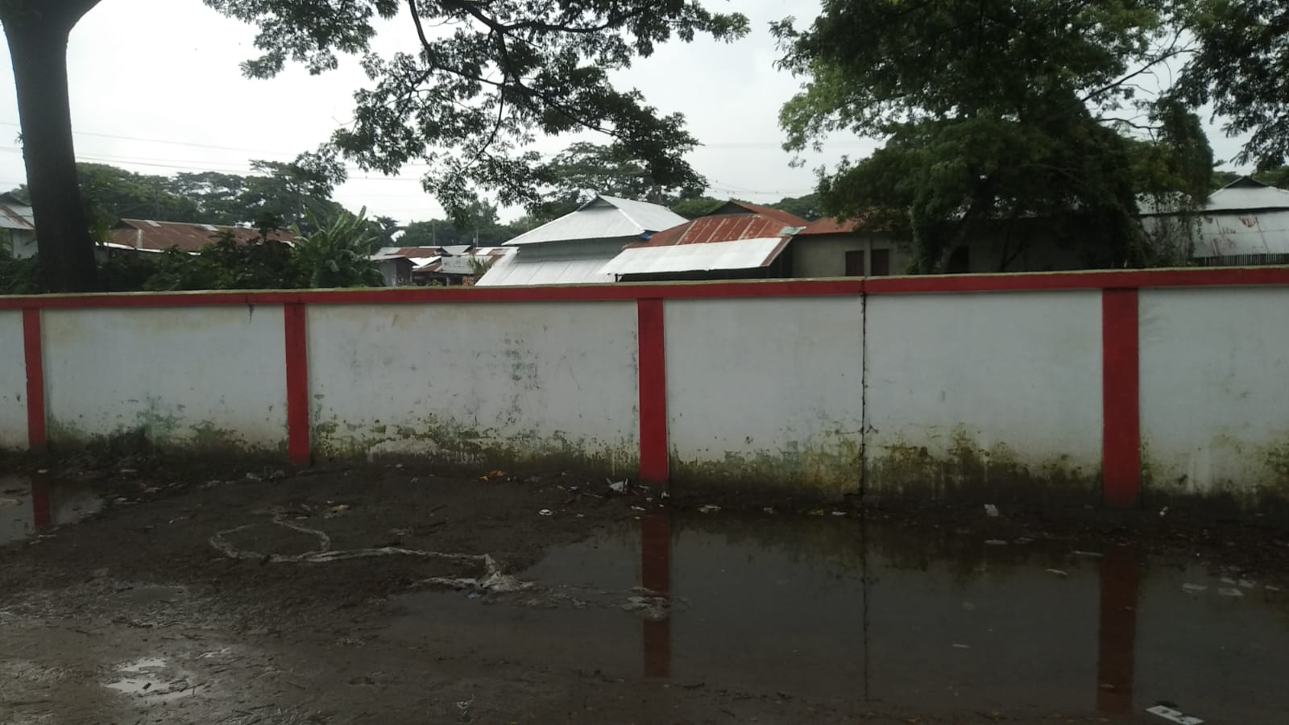
Protection of the Hospital Campus and Residential Area by Boundary Wall
Gate in front of Residential Area
Boundary Wall

Slide 19
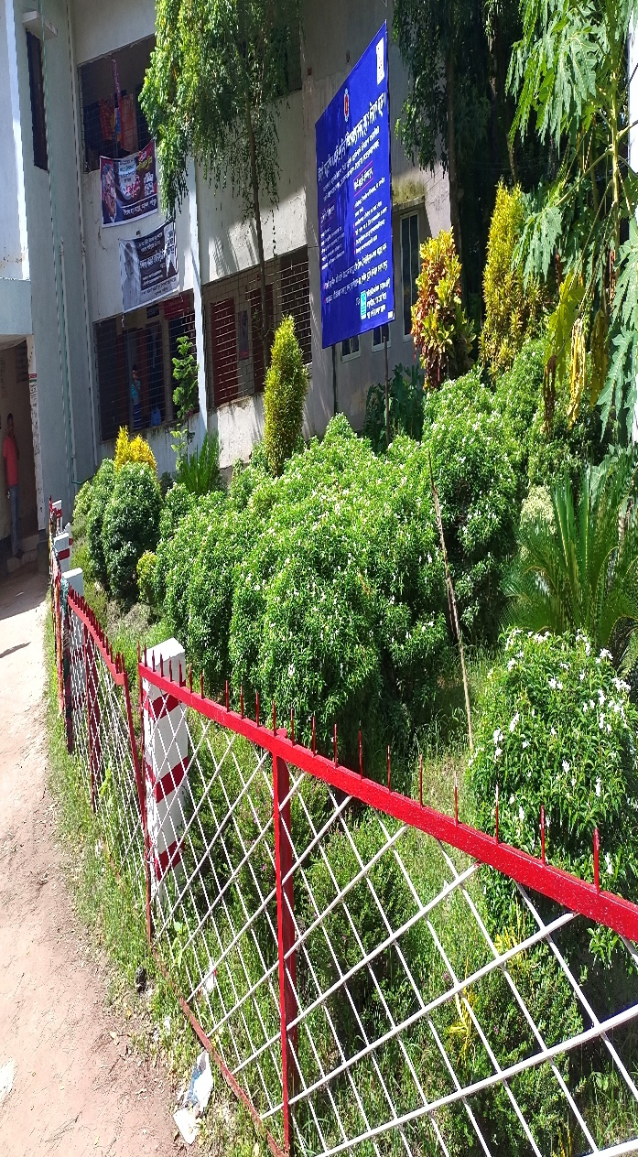
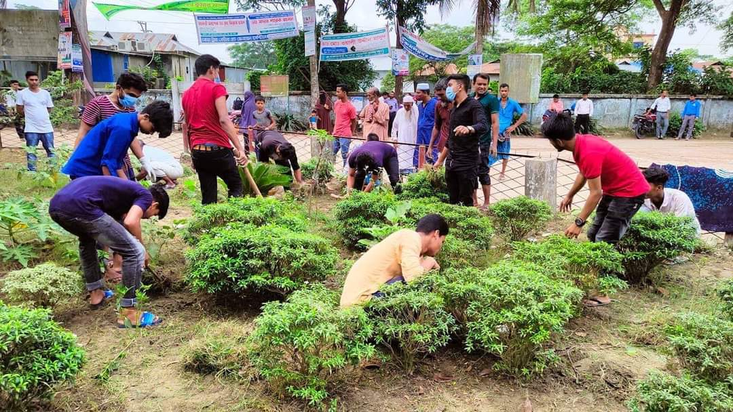
Beautification of the Hospital Campus
Beautiful Garden in front of the Hospital
Cleaning Day,
every Thursday

Slide 20
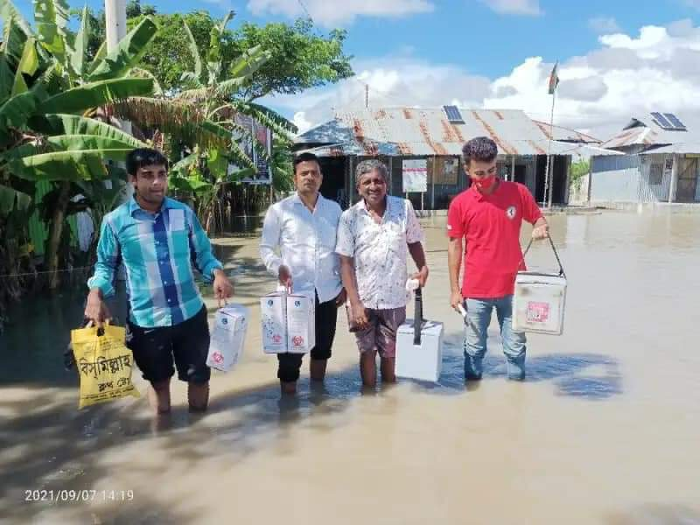
EPI activities in a Risk EPI Centre

Slide 21
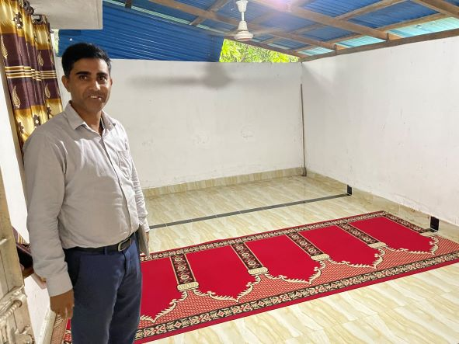
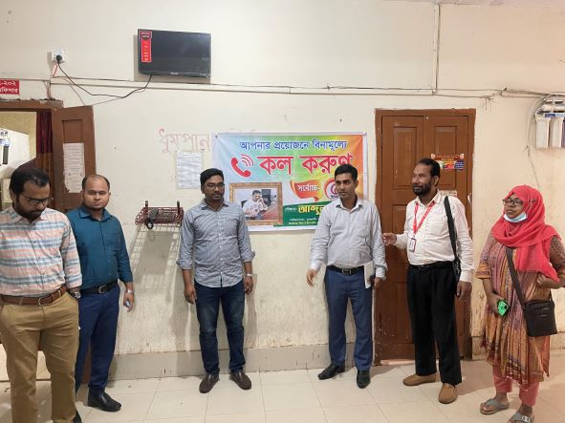
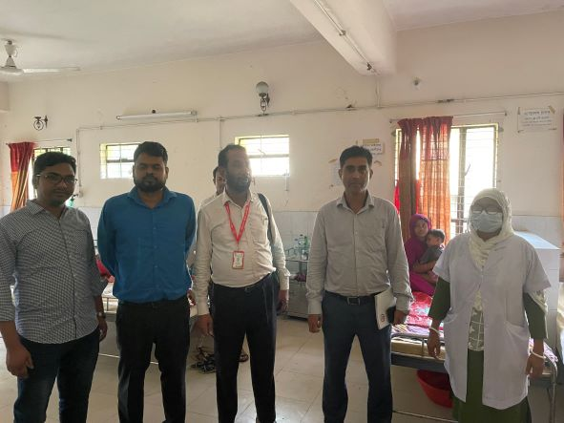
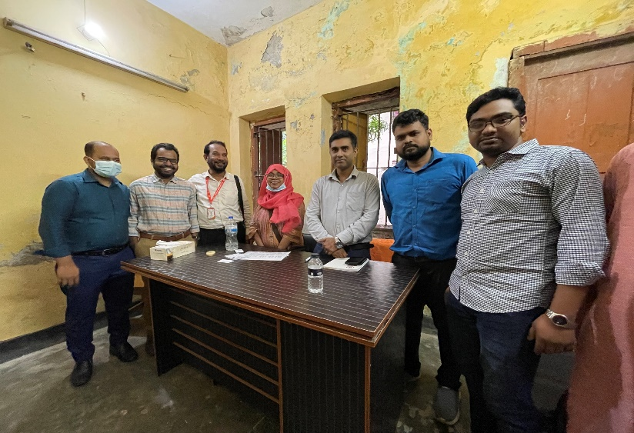
New Innovation
Female Prayer Room
Phone Booth free of cost
New Paediatrics Ward
Decoration by Medical Officer

Slide 22
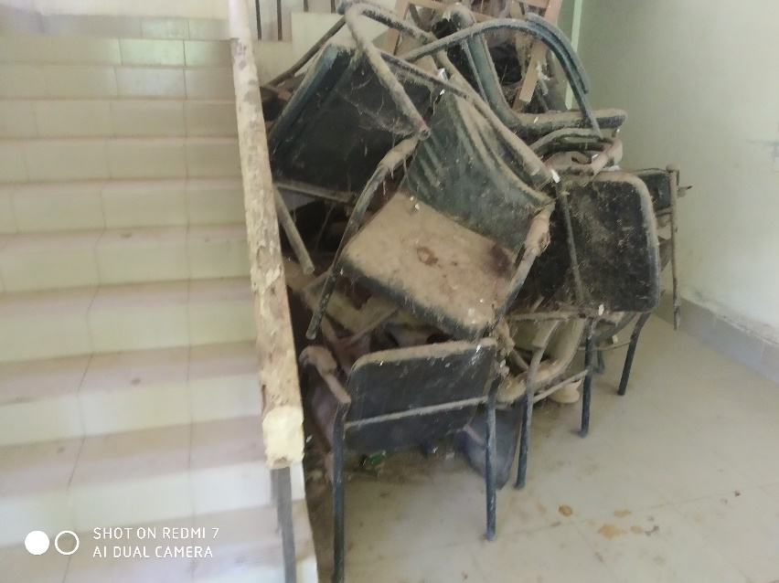
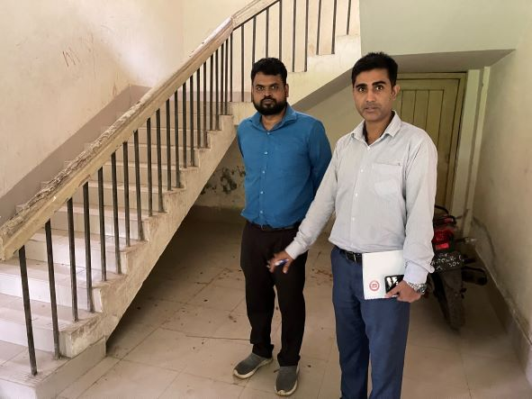
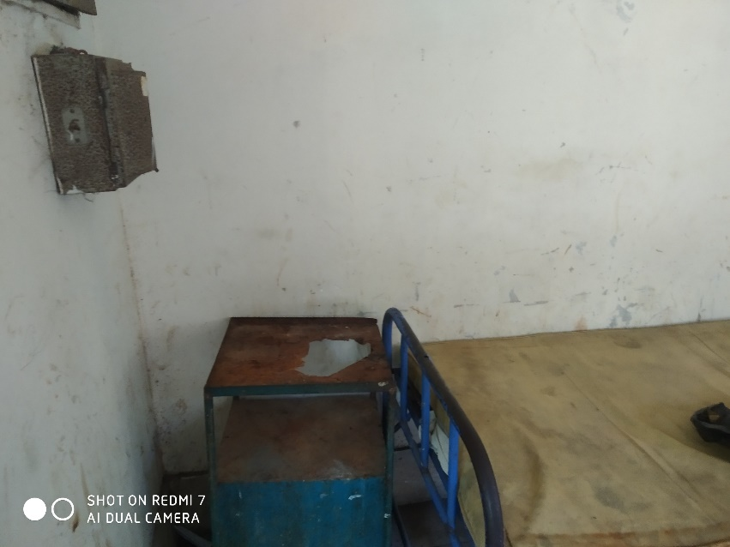
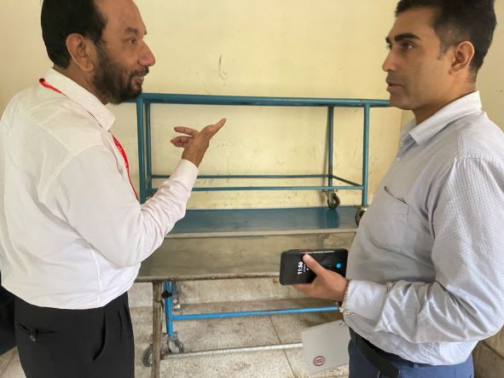
Removal of unwanted items
BEFORE
AFTER
BEFORE
AFTER

Slide 23
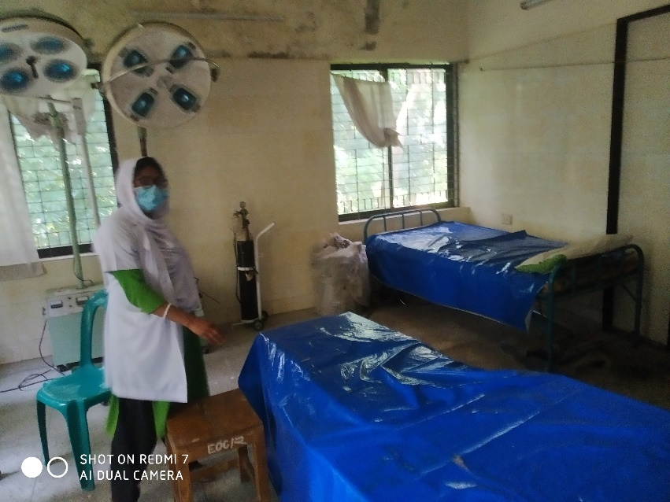
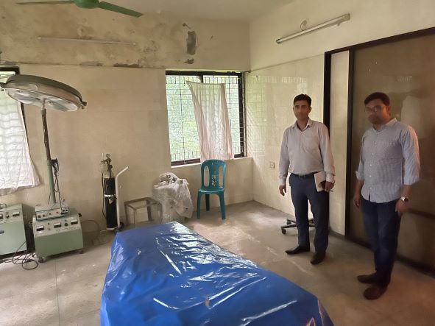
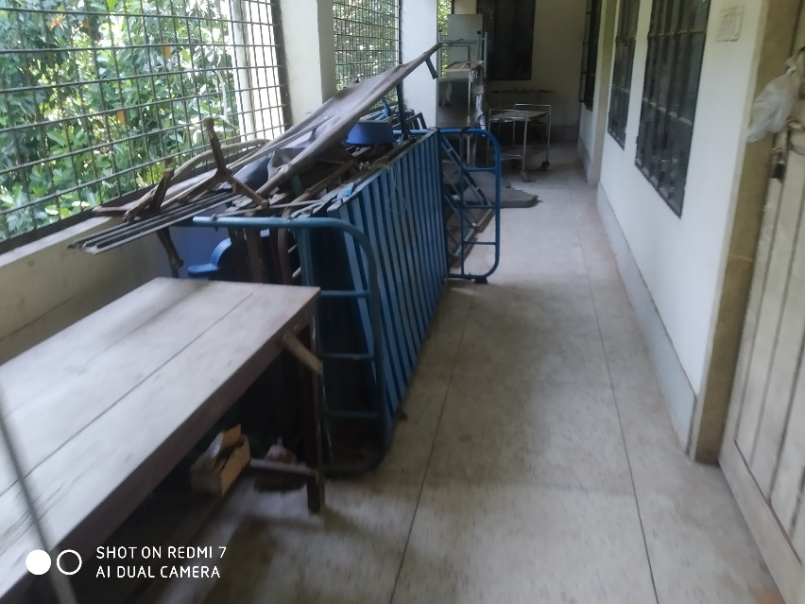
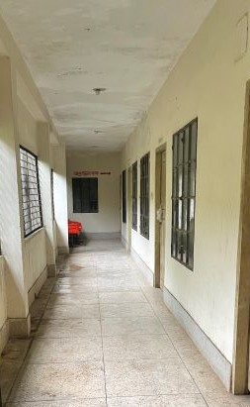
Removal of unwanted items from OT and Corridor
BEFORE
AFTER
BEFORE
AFTER

Slide 24
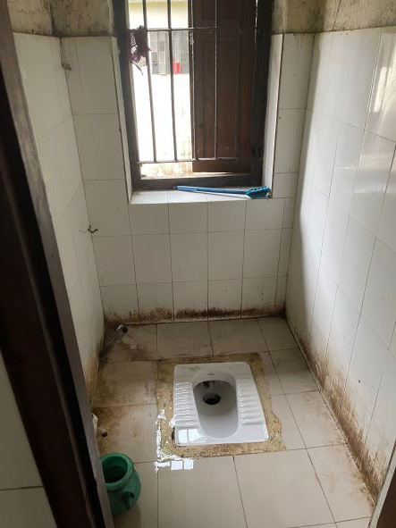
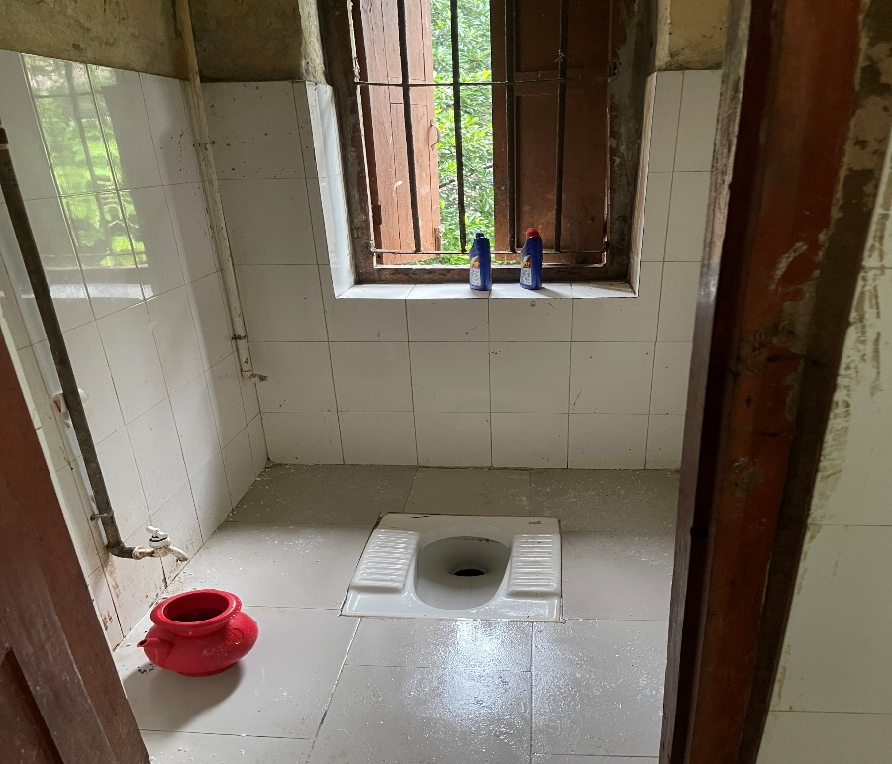
Cleanliness of Toilet
BEFORE
AFTER

Slide 25
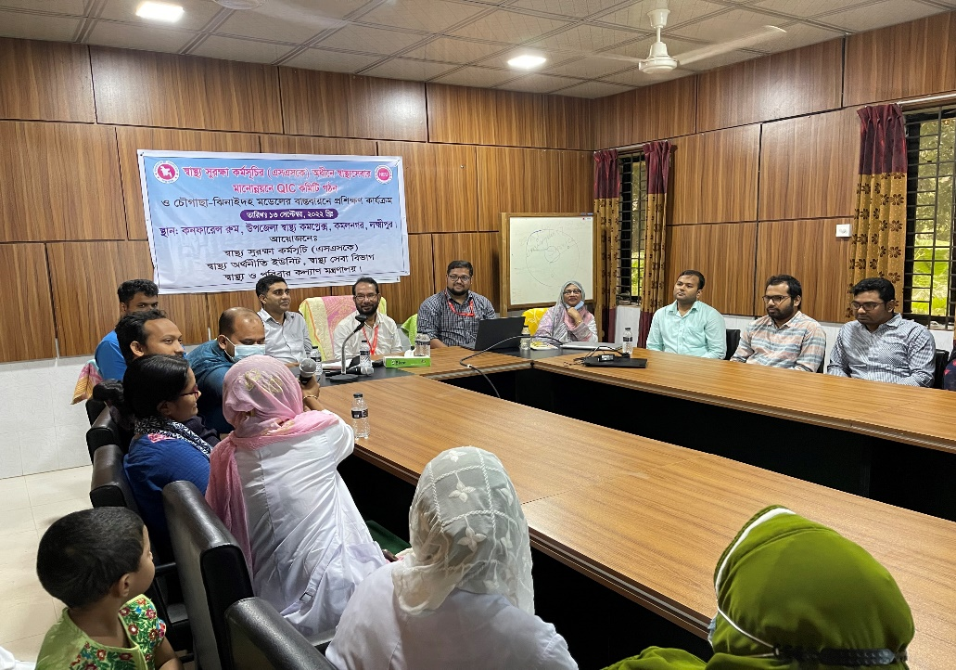
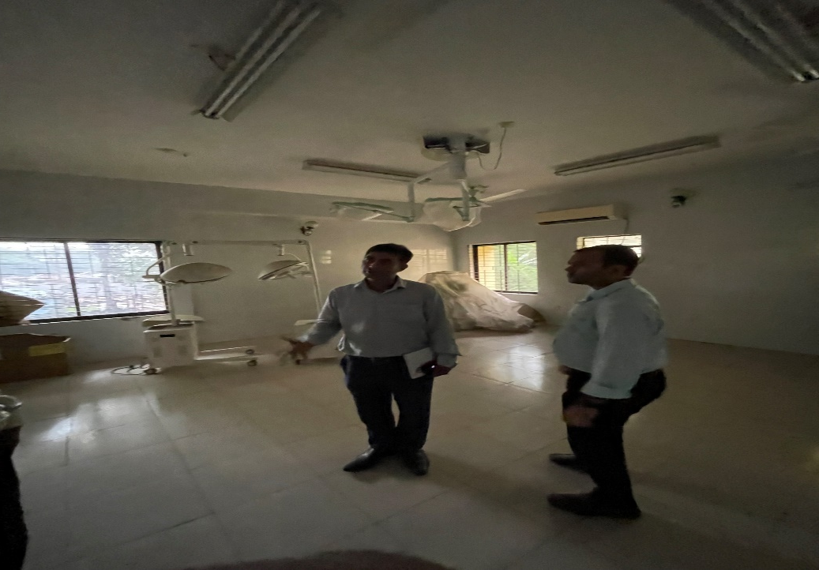
Training on Quality of Health Care and Renovation of OT Room
Training on Quality of Health Care
Renovation of new OT room

Slide 26
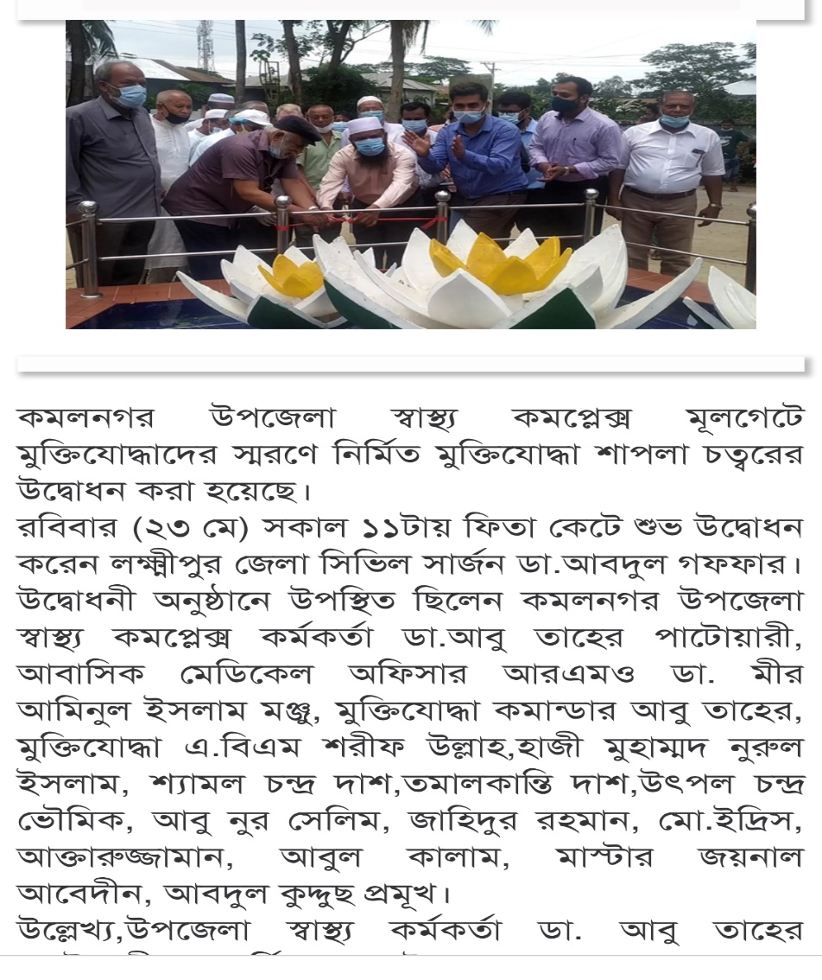
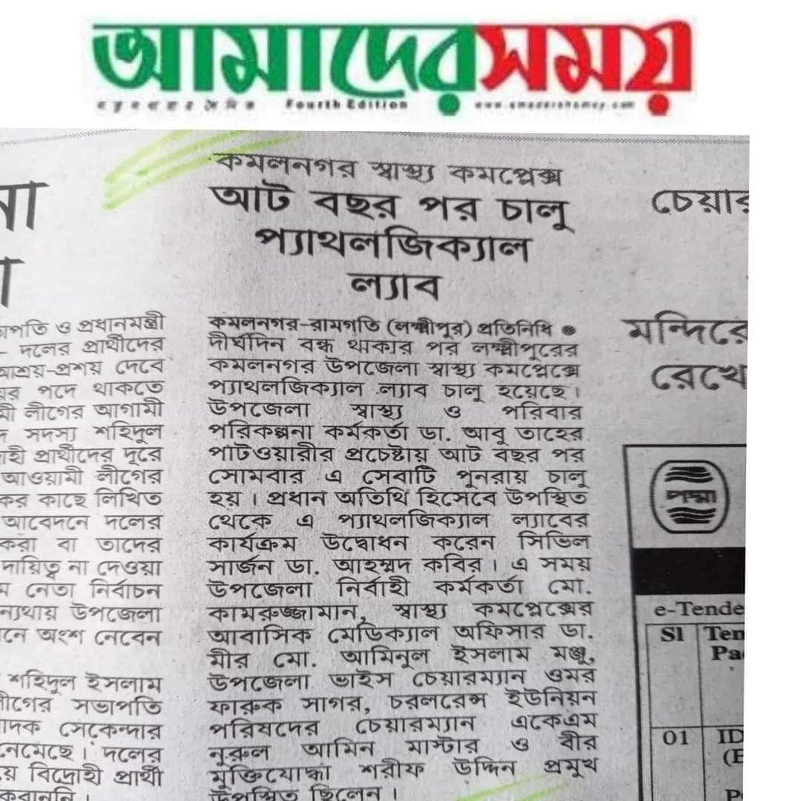
News paper coverage

Slide 27
Community Support in Kamalnagar UHC
One IPS & delivery instruments financed by JICA for 10 delivery centres in each union.
Central oxygen system financed and organized by Upazila Parishad.
Blood donated by about 100 enlisted blood donors in emergency need (Transfusion of 165 bag F/blood are given in 2021, 2022)
Fuel of Generator donated by MP and Upazilla Parishad .

Slide 28
Achievements of the UHC
A Jeep was allocated for UH&FPO by Govt.
Our corona vaccine coverage- 1st dose-86.25% and 2nd dose-81.3%
EPI coverage-99.99%
Establishment of Paediatrics ward.
Establishment of NCD corner.

Slide 29
Challenges
Many of the post of human resource are vacant or in deputation.
No store room in the Hospital
Main building of the Hospital is old and reconstruction is necessary.
The quarter of officers quarter and dormitory needs urgently reconstruction.
Reconstruction of the new building for 4 community clinic
Post creation of human resources of 50 bedded Hospital.

Slide 30
Way Forward….
Starting of VIA activities to prevent cervical and breast cancer of female.
Starting of C-section for delivery mother
Functioning of X-ray facility.
Establishment of USG service.
Implementation of effective SSK program.

Slide 31


